Slide 1

E-Voting
The Future
OF
Democracy

Slide 2
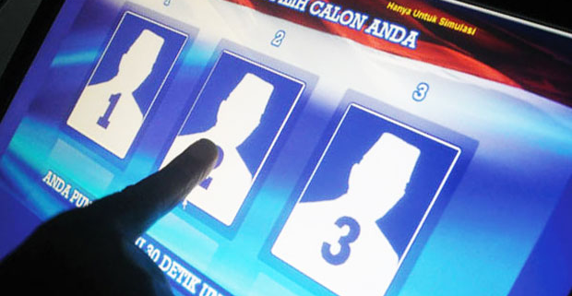
Bring The Better
Walk Slowly but never walk backwards

Slide 3
PREPARED BY
ANUSHIL TIMSINA
NITESH KUMAR DAS
SAKAR PAUDEL
SANDEEP SUBEDI

Slide 4
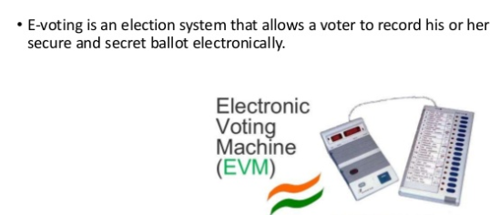
INTRODUCTION

Slide 5


TARGET
E-Voting System
Mannual Voting System
Time Consuming
Too Much Paper Work
Less Efficient
Late Result
Time Saving
Minimum Paperwork
Comparatively Efficient
Instant Result

Slide 6
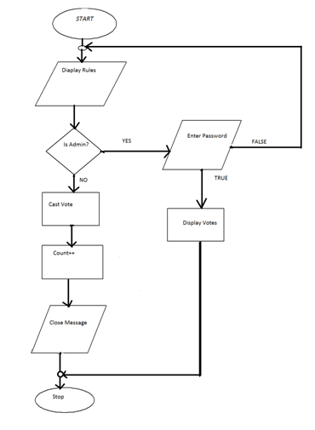
HOW IT IS PERFORMED?

Slide 7
EXPECTED OUTCOME
The expected outcomes can be stated as:
The person voting finds himself in the interface with rules.
The person elligible will have a chance to vote but only once and the casted vote cannot be changed.
Any person not elligible doesn’t get a chance to vote and a person cannot vote twice.
There will be a administrator mode which regulates voting by being able to access the number of votes that a candidate gets.

Slide 8
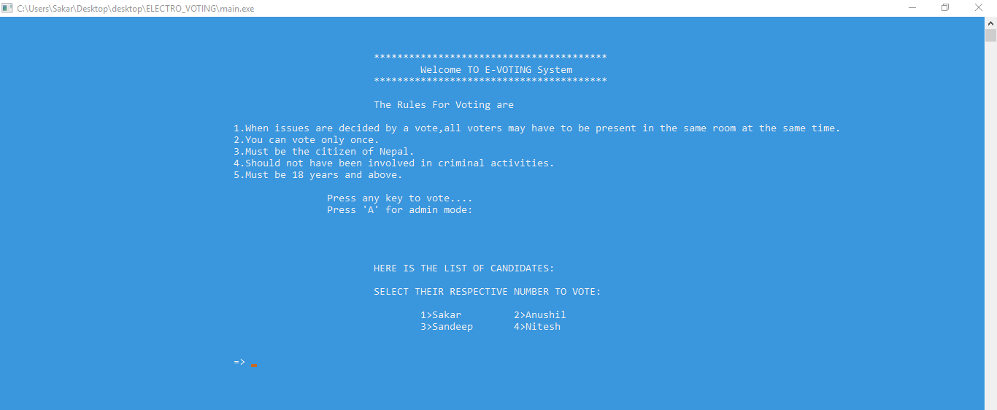
USER INTEFACE

Slide 9
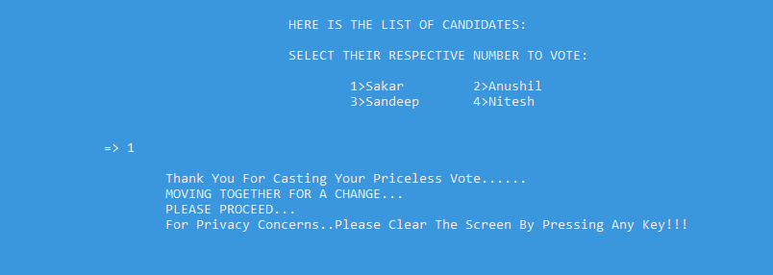
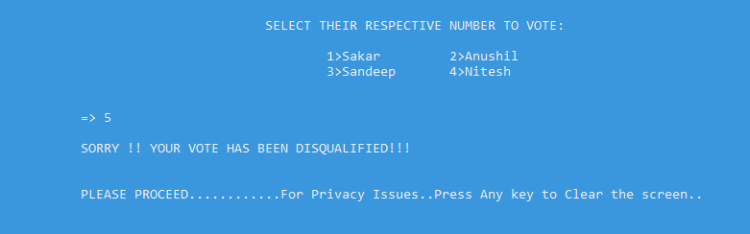
VALID AND INVALID VOTES

Slide 10
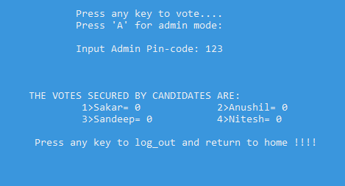
ADMIN MODE

Slide 11
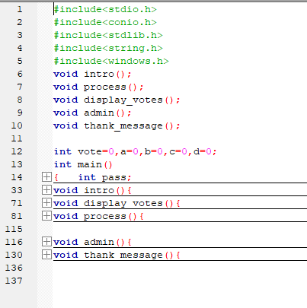
CODE AT A GLANCE
USE OF:
Functions
Windows.h
Switch
And more

Slide 12
ADVANTAGES
It is simple to use and understand.
There is a constituency link.
Provides strong government.
Reduces the representation of fringe parties

Slide 13
DISADVANTAGES
Huge capital investment is required.
The maintenance cost is very high.
It can create unemployment.
Continuous power supply is required.
Large inventories are required.
Security issues and unequal internet access.

Slide 14


